Slide 1
Therapeutic Thinking at Winnersh Primary School

Slide 2
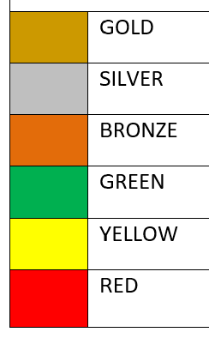
Why the need for change?
Our old behaviour system was very public, all children’s names were displayed on behavior charts in the classrooms, visually displaying to all which colour the children were on. We felt that this system had become quite outdated and over time our original message of ‘its good to be green’ had been lost. Inconsistency had become apparent and sometimes children were moving up increments of the chart reaching gold by carrying out non-negotiable behaviours.

Slide 3
Our Vision
At Winnersh Primary School we have decided to follow some of the principles of a Therapeutic Thinking approach towards our behaviour.
We believe that positive experiences lead to positive feeling and negative experiences lead to negative feelings. We want to create an environment where positive behaviours are more likely by proactively supporting pupils to behave appropriately.

Slide 4
Goals
A warm welcome for everyone
A passion for learning
The chance to take risks
Encouragement to keep going
Opportunities to share and celebrate achievements

Slide 5
Values
Get Involved
Show Respect
Embrace Challenge

Slide 6
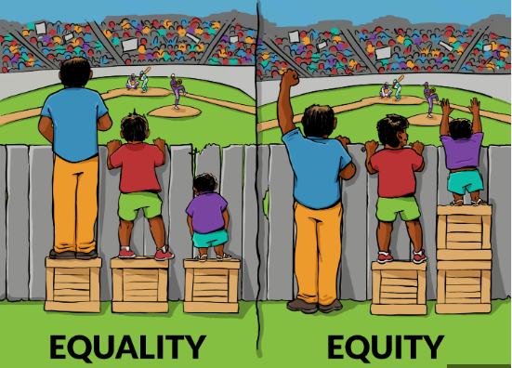

Slide 7
We want to promote prosocial feelings within our school
Prosocial Feelings
Liked | Loved | Respected
Involved | Included | Comfortable
Motivated | Safe | Encouraged
Able | Brave | Curious
Capable | Valued | Secure
Relaxed | Hopeful | Optimistic
Calm | Trusting | Determined
Tolerant | Needed | Kind
Inquisitive | Happy | Absorbed
Playful | Proud | Enthusiastic
Supported | Wanted | Understood
Antisocial Feelings
Angry | Sad | Alone
Worried | Lonely | Misunderstood
Cautious | Anxious | Embattled
Shamed | Blamed | Criticised
Hopeless | Scared | Withdrawn
Depressed | Fearful | Panicked
Naughty | Hurt | Ashamed
Reluctant | Judged | Powerless
Hopeless | Useless | Humiliated
Defiant | Tearful | Aggressive
Excluded | Unsure | Frustrated


Slide 8
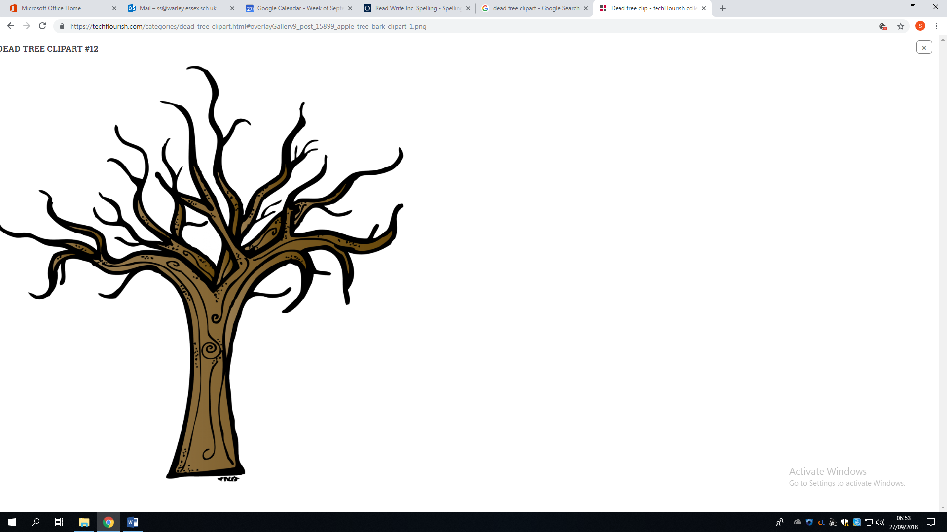

Anti-social behaviour difficult or dangerous
Pro-social behaviour
Labelled Blamed Shamed
Ignored Humiliated Targeted
Rejected Unimportant Isolated Irrelevant Ignored
Comfortable Respected Included
Safe Motivated Involved
Consulted Rewarded Needed
Inspired Liked Appreciated
Exclusion Missing out on stuff , Public Shame, Labelled, Blamed
Abuse, Neglect, Poverty, Bereavement, Difference, CLA, EAL
Pro Social experiences


Slide 9
What do our rewards look like to promote pro-social feelings within the school?


Slide 10
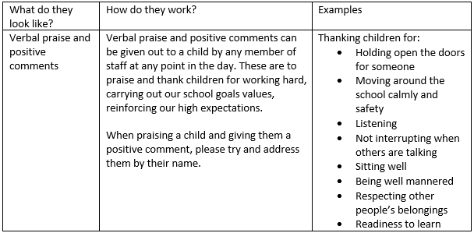
Verbal praise and positive comments

Slide 11
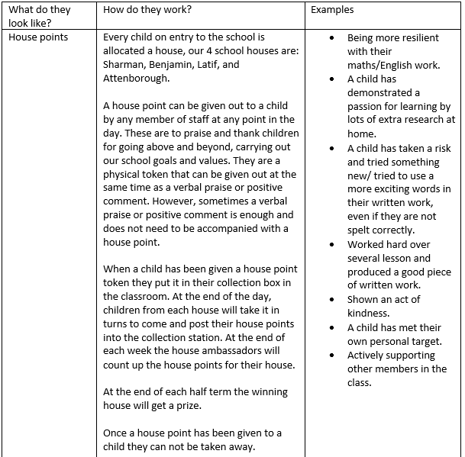
House Points

Slide 12
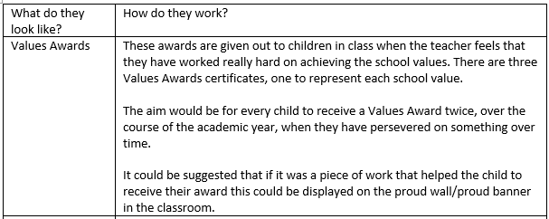
Values Awards

Slide 13
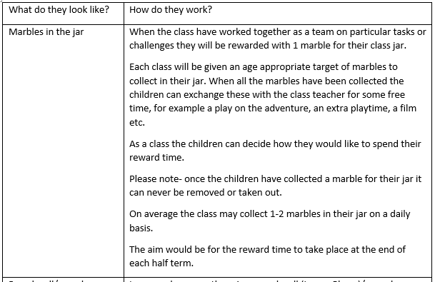
Marbles in the jar
These will look slightly different in every classroom depending on what they need to focus on as a class.

Slide 14
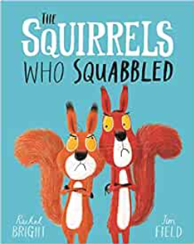
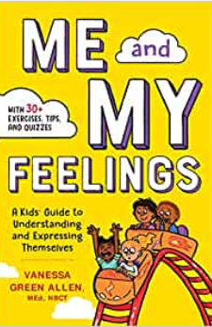

Wellbeing Sessions
These sessions take place on a weekly basis within the classroom.
During these sessions a range of wellbeing and mental health topics are shared and discussed, the starting point for most of these sessions is a book.
We want the children to build up their emotional literacy and vocabulary.

Slide 15
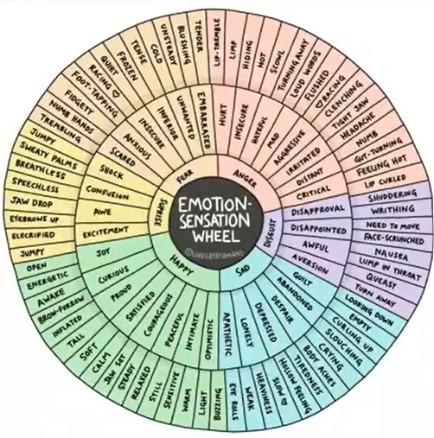
We have 6 basic emotional responses
-fear
-anger
-disgust
-sad
-happy
-surprise
All of our feelings sit behind these.

Slide 16
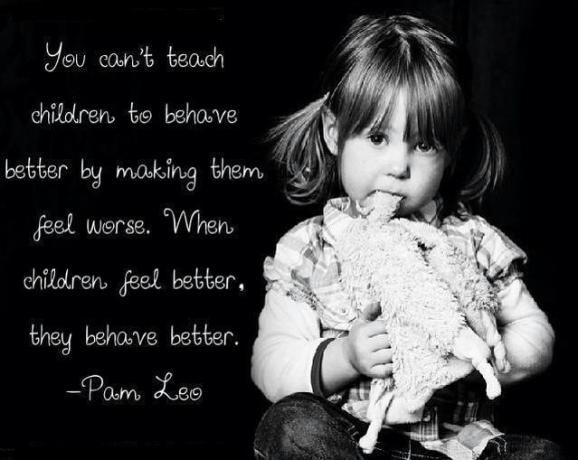

Slide 17
What do consequences in our school look like?


Slide 18
What do consequences look like when anti-social behaviours occur?
Where children show anti-social behaviours, it is appropriate and necessary for them to see the consequences to their actions. There are two types of consequences that should be used, Protective and /or Educational. In both cases the use of the word ‘obviously’ is essential in considering the consequence for the pupil. When carrying out conversations with children about their actions this should be done during their free time (break time and lunchtime).

Slide 19
Initial key questions
When consequences are being put in place staff members will need to consider:
What limits to freedom are necessary for safety or wellbeing following an incident?
How is the harm removed?
How long will these need to be in place? (Normally protective consequences are outcomes rather than time limited)
What are the educational consequences?
What does the child need to learn?
What do you need to teach them?
How are you going to teach them?

Slide 20
Educational Consequences
Educational consequences is to aid learning, rehearsing, or teaching so the freedom can be returned. In assessing the need for a consequence we will ask:
What happened?
What were people thinking and feeling at the time?
Who has been affected and how?
How can we put right the harm?
What have we learnt so we are able to make a different choice next time?

Slide 21
Interventions
What intervention could we use to support the discussions that have taken place?
Writing/drawing a sorry note
Practice sharing
Teach the children new games they could play at playtime/lunchtime
Model turn taking
Helping to fix what is broken (if it can be fixed)
Research the real world implications

Slide 22
Additional Support
For those children who need extra support to help regulate their emotions, these strategies maybe useful when de-briefing with the children when discussing what has happened:
Social stories
Role play with dolls/teddies
Comic strip conversations
Emotion cards
For the teachers and LSA’s to complete a Therapeutic Plan for the child and share with the parents/careers.
When completing the Therapeutic plan we need to consider:
What type of praise do they respond best to?
What causes them anxiety? How can we help support them with this?
What dangerous behaviours might they present?
What might recovery look like?
What strategies can we use to help support the child?

Slide 23
Protective Consequences
Protective Consequences is a removal of a freedom to manage harm. They are used when required to protect the rights of others and could include:
Increased staff ratio
Change of timetable
Arrangements to access outside space e.g. playground/field.
Differentiated teaching space; hall, outdoor area, little kitchen, Starlight Hub
Appropriate use of exclusion

Slide 24
How can parents help at home?
Encourage your child to talk about your feelings and their feelings – happy, sad, bored, angry, irritated, or excited. It is ok and normal to feel all these things. Let your child know that it is how we learn to respond to our feelings that is so important.
Engage in fun activities together e.g. going to the park, going for a walk, baking together, engaging in community activities, playing a family board game or talking around the dinner table.
Encourage your child to stick at something they find difficult: support them with a difficult piece of work, a tricky jigsaw puzzle, a long walk, or a challenging sporting activity. This will build up their confidence and promote their positive feelings about themselves.

